Slide 1
Vali IT
Liquibase

Slide 2
Liquibase
Liquibase is tool for managing and applying database schema changes.

Slide 3
Liquibase
Add liquibase dependencies to pom.xml
<dependency>
<groupId>org.liquibase</groupId>
<artifactId>liquibase-core</artifactId>
</dependency>

Slide 4
Muuda applicaiton.properties
spring.liquibase.change-log= classpath:/db/changelog/changelog-master.xml

Slide 5
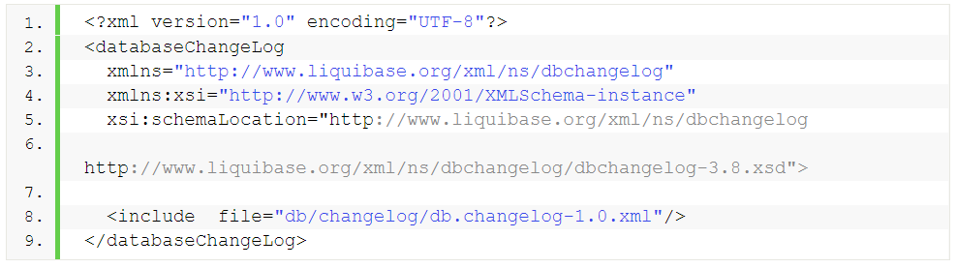
changelog-master.xml
https://www.liquibase.org/get-started/best-practices

Slide 6
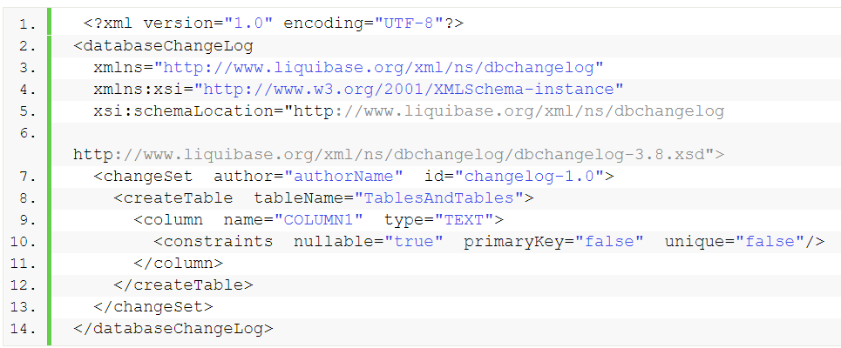
Db.changelog-1.0.xml

Slide 7
Foreign Key
id | account_nr | balance | user_id
1 | EE00123 | 125 | 1
2 | EE00124 | 9930 | 3
Id | name
1 | Siim
2 | Test
????
Foreign key would not allow inserting of such row

Slide 8
Foreign Key
<column name="employee_id" type="int"> <constraints nullable="false" foreignKeyName="fk_address_employee" references="employee(id)"/>
//”tabeli_nimi(tulba_nimi” </column>

Slide 9
Liqubase documentation
https://docs.liquibase.com/concepts/basic/xml-format.html

Slide 10
Liqubase basics
Liquibase uses 2 tables (databasechangelog, databasechangeloglock)
It stores all executed changesets
It will only run changesets that have never been executed
You are not allowed to modify changeset after it has been exectued

Slide 11
Ülesanne BankController
Loo uus meetod createClient kus sisestakase kliendi andmed ja tagastatakse kliendi id
Täienda meetodid createAccount, et ta peab sisse lugema ka cliendi id
Loo uus tabel transaction_history
Iga kord kui tehakse deposit, withdraw või transfer lisa kirja transaction_history tabelisse tegevuse sisuga

